Slide 1
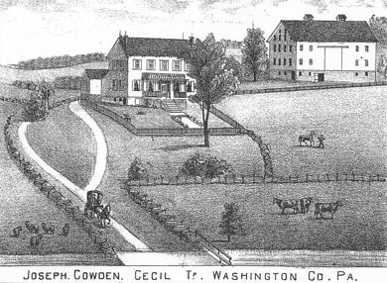
The Cecil Township Agricultural Security Area
October, 2021

Slide 2
Materials For The ASA Review
Agricultural Security Area Handbook
Agricultural Security Law
Ordinance’s Establishing and Continuing the ASA
Ordinance No: 8-1993 Added 51 parcels totaling 3,935.19947 acres
Ordinance No: 3-1995 Added 16 parcels totaling 261.3571 acres
Ordinance No: 6-1999 Added 5 parcels totaling 138.30 acres
No additional Ordinances were adopted by the BOS after June 1999. Additional parcels totaling 172.612 acres were added between 1999 and 2021.

Slide 3
What is an Agricultural Security Area?
Act 43 of 1981 allows any owner of land used for agricultural production to submit a petition to their municipality for creation of an Agricultural Security Area (ASA).
ASAs require at least 250 acres of viable agricultural land and are created by the municipality. The initial seven year term of an ASA is followed by a re-certification process.

Slide 4
What is an Agricultural Security Area?(cont.)
Agricultural Security Areas promote more permanent and viable farming operations over the long term by strengthening the farming community's sense of security in land use and the right to farm.
Established in 1981 as a tool for strengthening and protecting agriculture in Pennsylvania, farm owners in the ASA can help preserve the viability of Pennsylvania farms by working together to establish such Areas.

Slide 5
What is an Agricultural Security Area (cont.)?
There are multiple benefits to establishing an Agricultural Security Area (ASA):
participating farmers are entitled to special consideration from local and state government agencies if a farm is proposed for condemnation
participating farmers are protected from some "nuisance" challenges, which help to encourage the continued use of farmland for productive agricultural purposes.
At the time of this publishing, roughly four million acres of land are enrolled in Agricultural Security Areas statewide.

Slide 6
The ASA in Cecil Township
The ASA in Cecil Township was established in Cecil Township by Ordinance 8-1993 pursuant to Act 43 of 1981 (3 P.S. 901 et seq.) known as the Agricultural Area Security Law.
Ord 8-1993 set forth a minimum of 10 acres per tract to participate at no cost to subscribers.
Non-adjacent properties can participate in the ASA however, all activities associated with the application to join the ASA must net a minimum of $2,000 per year for farm related activities.

Slide 7
The ASA in Cecil Township (cont.)
51 parcels totaling 3,935.19947 acres established the ASA in 1993 and later additional parcels were added.
Ordinance 8-1993 was recorded in the Washington County Recorder of Deeds Office in Deed Book 2556 Page 276 on October 28, 1993.

Slide 8
The ASA in Cecil Township (cont.)
Ordinance 3-1995 added 16 additional parcels totaling 261.3571 the existing ASA and amended Ordinance 8-1993 by deleting Paragraph 3 and replacing it with:
“Applicants for inclusion in the Agricultural Security Area shall submit the
necessary applications to the Township on or before that last day of May
and the last day of January.”
Recorded in Deed Book 2690, page 168 on May 3, 1995, bringing the total number of ASA participants to 67 and total acreage covered by the ASA to 4,196.5565 acres.

Slide 9
The ASA in Cecil Township (cont.)
On February 20, 2014, three proposals for three separate parcels were recorded with the Washington County Recorder of Deeds Office and added a total of 173.182 acres to the existing ASA. However, no Ordinances were prepared, considered by the Board of Supervisors and/or made a part of the record for these three parcels. Only the proposal forms were recorded as evidence of ASA participation.
Total participants in the Cecil Township ASA as of July 30, 2021, is 75. Total acreage is 4,727.0125 acres. Out conveyances from participant parcels (i.e., Kemp property divided into 13 parcels) have not been considered at this time but will be in the final submission to the Cecil Township Board of Supervisors.

Slide 10
Who Can Participate?
Landowners with property that meets the following conditions may apply to be in an Agricultural Security Area:
Noncontiguous farm parcels must be comprised of 10 acres in size or more or have an anticipated yearly gross income of at least $2,000 from agricultural production.
NOTE: The farm tracts that are required in order to create a new 250-acre or larger Agricultural Security Area do not have to be under the same ownership or even be located in the same municipality.

Slide 11
Who Can Participate? (cont.)
The property must be viable agricultural land. Cropland, pasture, and woodland can all be included in an Agricultural Security Area.
Land proposed must have soils that are conducive to agriculture. This factor will ,be automatically satisfied if at least 50% of the soils are classified in Classes I-IV or if the soil is currently in active farm use and is being maintained in accordance with a soil erosion and sedimentation plan.

Slide 12
Who Can Participate? (cont.)
The property must be zoned to permit agricultural uses, but does not need to be zoned to exclude other uses.
Additional factors to be considered are the extent and nature of farm improvements, anticipated trends in agricultural economic and technological conditions, and any other relevant factors.

Slide 13
Participation
Participation in the Agricultural Security Area is available on a voluntary basis
Landowners must be within the jurisdiction of the governing body
If a landowner wishes to enroll in the Agricultural Security Area after the Area is originally established, he or she may still enroll.

Slide 14
Benefits of Enrolling Land (cont.)
An ASA designation is a prerequisite for eligibility in a county farmland preservation program.
In counties that have established farmland preservation programs under the Agricultural Area Security Law, farms located in an ASA consisting of at least 500 acres may apply for the purchase of an agricultural conservation easement by the Commonwealth.

Slide 15
Benefits of Enrolling Land
Municipalities are not permitted to enact local laws or ordinances that would unreasonably restrict farm structures or farm practices within the ASA.
Any municipal law or ordinance which defines or prohibits a public nuisance must exclude any agricultural activity or operation that uses normal farming practices within an ASA. This serves as a check against municipal ordinances that may unreasonably restrict agriculture.
All Commonwealth agencies must encourage the maintenance of viable farming in ASAs.

Slide 16
Benefits of Enrolling Land (cont.)
Generally, no Commonwealth agency which has powers of eminent domain may condemn land within an Agricultural Security Area that is being used for productive agricultural purposes (not including the growing of timber) unless prior approval has been obtained from the Agricultural Lands Condemnation Approval Board (ALCAB).
The ASA designation does not restrict the use of the property by the farmer. The farmer or any subsequent owners may develop, sell, or subdivide the property in any manner authorized by local zoning and subdivision and land development regulations.

Slide 17
Benefits of Enrolling Land (cont.)
The farmer is obligated to maintain the ASA status of the farm for seven years after the initial application. After the initial seven year period, the farmer may have the ASA designation removed at any time by submitting a written request to the municipality.
The ASA designation will stay with the property when it is sold or subdivided.

Slide 18
Benefits of Enrolling Land (cont.)
The only way a property can be removed from an ASA is through the action of the property owner or through a formal hearing process conducted by the municipality.
The municipality may review the ASA every seven years or during the seven year period if there has been significant change of use of the properties located within the ASA.

Slide 19
Benefits of Enrolling Land (cont.)
The property owners of the ASA designated property must be notified in writing of the review. If the municipality fails to review the ASA at the seven year interval, the ASA is automatically renewed for an additional seven years.
The ASA designation will stay with the property when it is sold or subdivided if remainder is 10 acres or more.

Slide 20
Benefits of Enrolling Land (cont.)
The only way a property can be removed from an ASA is through the action of the property owner or through a formal hearing process conducted by the municipality.
The municipality may review the ASA every seven years or during the seven year period if there has been significant change of use of the properties located within the ASA.

Slide 21
Benefits of Enrolling Land (cont.)
The property owners of the ASA designated property must be notified in writing of the review. If the municipality fails to review the ASA at the seven year interval, the ASA is automatically renewed for an additional seven years.

Slide 22
Planning Commission’s Role in the ASA Seven Year Review Process
The hierarchy
1. Pennsylvania Agriculture Department
2. Washington County Planning Commission
3. Cecil Township Planning Commission
4. The ASA Committee

Slide 23
Planning Commission’s Role in the ASA Seven Year Review Process
Review the work of the ASA Committee on the seven year review
Accept, modify or deny ASA Committee recommendations on the seven year review
Advance the seven year review to the Board of Supervisors a/k/a “the governing body”

Slide 24
Schedule of Events
October 15, 2021
Run ad in the Washington Observer for the upcoming Seven Year Review of the ASA
30-day prior to review governing body review starting November 15, 2021
Mail notices and letters to current participants in the ASA (100 plus)
Post the notices in the at least five different locations in Cecil Township
All Cecil Post Offices
Lawrence Post Office
All fire departments
Lawrence Community Center
Municipal Building
Post notice online on our website; FB page

Slide 25
Schedule of Events
October 15 through November 15
30 days prior to review window of November 15 through November 30
Review current participants, out conveyances and subdivisions
ASA committee meetings and discussions
NOTE: Must meet with Planning Commission on November 18
October 21, 2021
Discuss the ASA with Planning Commission
Expectations
Handouts
Exhibits
Procedures

Slide 26
Schedule of Events
November 16
ASA Review starts
Address all modification requests by current residents
November 18
ASA committee to meet with Planning Commission Members
December 1
Cecil Township Board of Supervisors to consider the ASA Resolution for the Seven Year Review

Slide 27
Wrap Up
The ASA is beneficial to all landowners of 10 acres or more
It protects larger land owners from nuisance Ordinances
Parcels under the ASA can be removed by the current owner and/or Board of Supervisors as in the case of McConnell’s Trails
There is no cost to the Twp. or the landowners to belong to or be removed from the ASA
Once the total acreage in the ASA drops below 250 acres, the ASA is automatically dissolved
A seven year review MUST be administered or fines will be levied

Slide 28
Forms Used For the ASA
Two Forms to Use
- Pa Department of Agriculture ABFP-14, Rev 4/2005 “Proposal for the Addition of An Agricultural Security Area”
- Pa Department of Agriculture ABFP-15, Rev 4/2005 “Proposal for the Removal of An Agricultural Security Area”

Slide 29
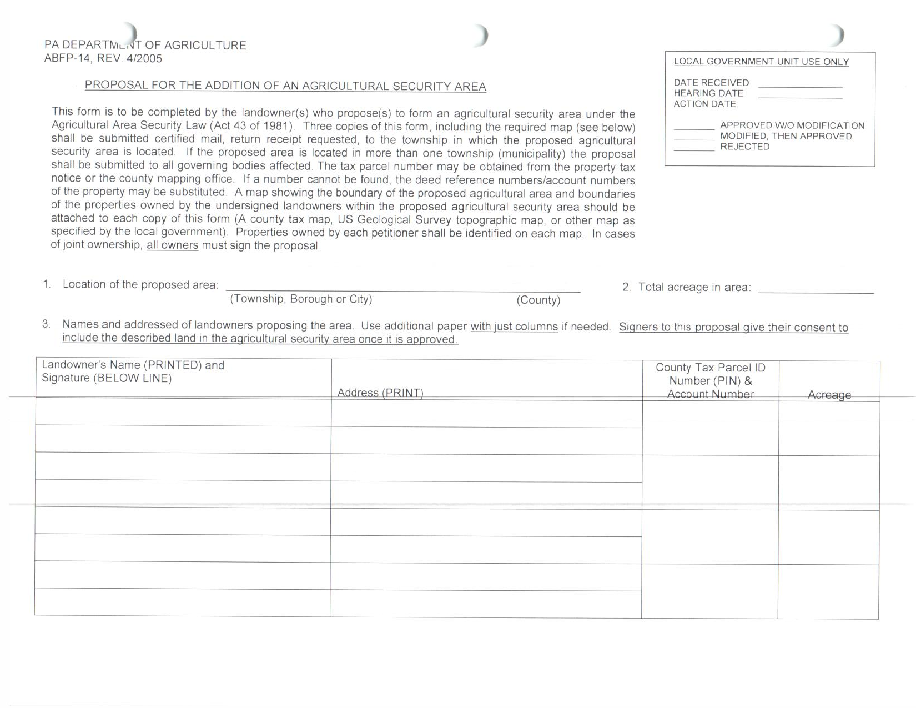
ASA Admission Form

Slide 30
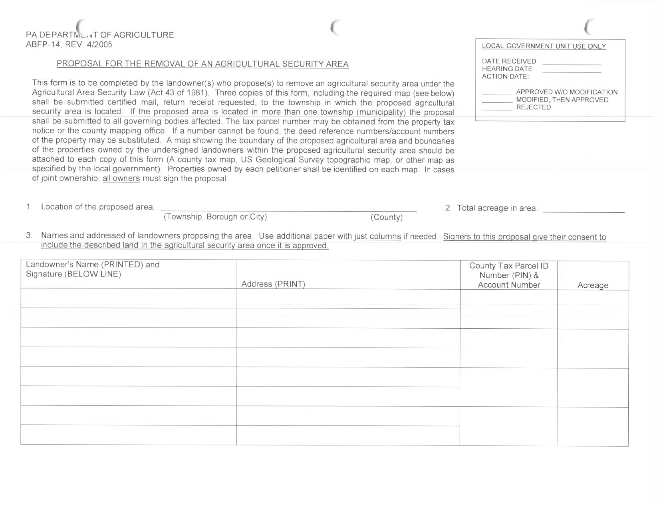
ASA Removal Form

Slide 31
ASA Addition/Removal Process
Interested party (land owner) contacts ASA representative (i.e., Jacque King)
- Land owner requests property to be added to or removed from the existing ASA
- Land owner completes either add or removal form (See above)
- Land owner delivers completed form to the Twp. Planning Director
- Twp Planning Director records completed form with the Washington County Recorder of Deeds Office at Twp expense

